Slide 1
Fundamentals of Databases Level 4
Introduction to Databases & Modelling
Lecture 1
Meg Soosay
using materials developed by Lesley Earle

Slide 2
Overview
Introduction to the module
What are databases, who uses them and how are they developed
Conceptual Analysis
Data Modelling –
Entities
Entity Relationship Diagrams
Entity Descriptions

Slide 3
Module Aims
To introduce you to the stages involved in the development of database systems
Analysis & Design - Data modelling
Introduces the basic development processes used to build a database
Using ORACLE 19c
with APplicationEXpress (APEX 19.1.0 )

Slide 4
Learning Outcomes
Produce a database model and design for a complex set of user requirements.
Appreciate the rationale for, and the organisational context within which databases are developed whilst appreciating data protection issues.
Build a database system to meet the requirements of a simple business application.

Slide 5
Learning Methods
Lectures – Vital as introduction to key topics
Videos of the lectures will be available on VLE
Workbook - used in practical sessions
4 Hours of self study per module per week
VLE – a range of additional activities e.g. additional exercises, on-line quizzes, reading, practical exercises, self assessment etc.
All weekly tasks listed in workbook should be completed before the following week’s practical session.
Module Guide lists the weekly topics

Slide 6
Assessments
TWO assessments
Assessment 1 Week 7 worth 40%, for 1 hour during your tutorial session. Closed Book
Entity Relational model and Entity Description table for case study
VLE multiple choice test
Practical Test Week 13 worth 60%, for 1 hour 50 mins during your tutorial session. Open Book
Practice tests and formative self assessment activities also available on VLE

Slide 7
Who uses Databases?

Slide 8
Who uses Databases - nearly everyone?
SOCIAL NETWORKS – Facebook, Twitter
UNIVERSITY – student records, results
BANKS – bank accounts, transactions
POLICE – national computer, links to other systems, international
INLAND REVENUE – tax and payment records
NHS – medical records, appointments, tests
GOVERNMENT – council tax, electoral role
BUSINESS large and small – accounts, payroll, stock control, data warehousing, data mining, auction sites, …

Slide 9
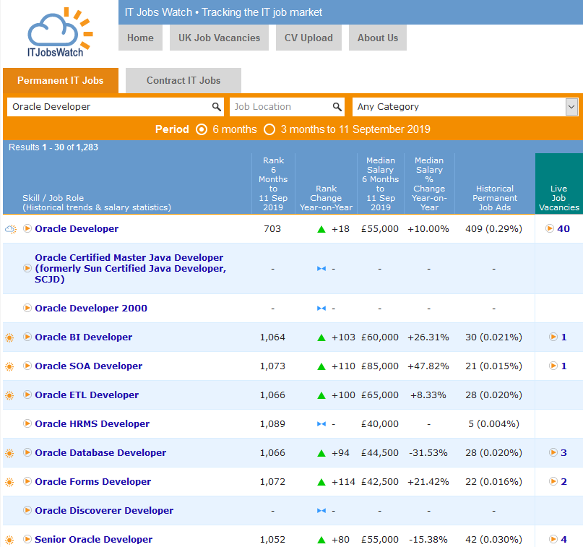
Jobs in Oracle (IT Jobs Watch Sept 2019)

Slide 10
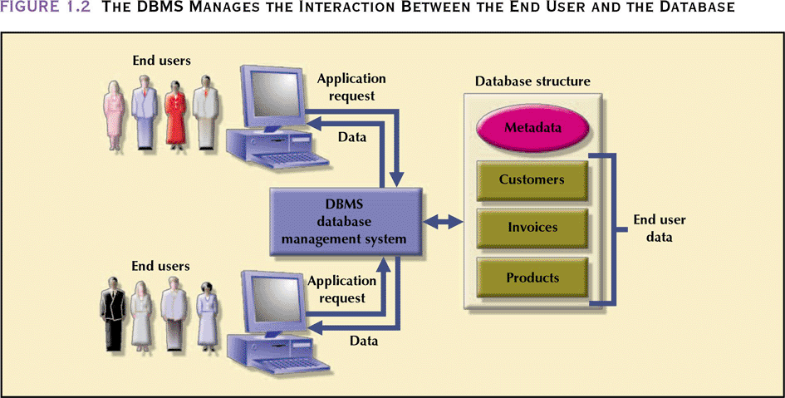
The Database Management System (DBMS)
Including Data Dictionary

Slide 11
Types of Databases
Hierarchical Databases – represents data as hierarchical tree structure starting at a single root to which all other data is linked
Network Databases – an extension of the hierarchical with more than one single root organised with more relationships between the data, so was faster
Relational Databases – data organised in two dimensional tables with relationships maintained between tables
Object-Oriented Databases – defined in terms of objects, their properties and their Hierarchical Model operations

Slide 12
Types of Databases
Hierarchical Databases – represents data as hierarchical tree structure starting at a single root to which all other data is linked
Network Databases – an extension of the hierarchical with more than one single root organised with more relationships between the data, so was faster
Relational Databases – data organised in two dimensional tables with relationships maintained between tables – Implemented using ORACLE
Object-Oriented Databases – defined in terms of objects, their properties and their Hierarchical Model operations

Slide 13
Database Design Stages
Analysis from a Data driven perspective
Conceptual
Analysis
Logical
Design
Physical Implementation
Relational Databases output Entity Relationship Diagrams
Notes:
Start with Conceptual model then Logical model then Physical implementation
Conceptual Analysis – ERD’s
Logical Design - Relations

Slide 14
Entity Relationship Diagram
Entities and their relationships shown on an Model - CASE tools e.g. QSEE or SemanticPad

Slide 15
Entities or more formally Entity Types
Entity (Type) something the system needs to store data about
‘An entity is a thing of interest to a system about which data is kept’ (Lejk and Deeks, 2002)
They can be:
Tangible Objects
Roles played
Sites or Locations
Organisational Units
Events or Transactions
Defined in the singular and named in uppercase
Represented as a rectangle on Entity Relational Diagrams
Entity Descriptions are also an important part of the data dictionary

Slide 16
Attributes of Entities
‘An attribute is an item of data held about an entity’ (Lejk and Deeks, 2002)
Each entity has defined an attribute structure
For an entity BOOK, what attributes might there be?
What about an entity STUDENT?
How do you know which BOOK or STUDENT you are referring to?

Slide 17
Attributes of Entities
‘An attribute is an item of data held about an entity’ (Lejk and Deeks, 2002)
Each entity has defined an attribute structure
For an entity BOOK, what attributes might there be?
What about an entity STUDENT?
How do you know which BOOK or STUDENT you are referring to?
Need an Identifying Attribute!

Slide 18
Occurrences of Attributes
Values for the attributes for a particular instance of on entity
The entity instance will have values for each attribute, although some can be empty or NULL
The entity instance will be uniquely identified by identifying attribute
For the STUDENT entity your data will form an occurrence in our system
For the entity BOOK the data about each book in the library will form an occurrence

Slide 19
Entities, Attributes and Occurrences
Entity Type FOOTBALLER
Entity Description A registered player of football contracted to play for their country
Entity Occurrence Harry Kane
Identifying Attribute FootballerId
Attributes surname, firstnames, DOB,placeofbirth
Attribute Values Kane, Harry Edward, 28/07/1993, Walthamstow

Slide 20
Entity Relationship Diagram
Entity (Type) something the system needs to store data about
Identify Candidate Entities (possible entities)
Ensure all 4 Tests of an entity type apply
Test one | The object should be of importance in the system being studied
Test two | There should be data attributes that can be associated with the entity
Test three | There should be more than one occurrence of this entity type
Test four | It should not be an attribute of an entity

Slide 21
Identify Entity Types
Formula One example
There are 11 F1 Teams e.g. Mercedes, McLaren, Ferrari, Williams etc. which engage drivers to take part in the F1 World Championship. Each F1 Team is based in one country e.g. Williams and McLaren are British, Mercedes is German etc. F1 Teams contract drivers to race for them in the 20 races which take place each year.

Slide 22
Identify Candidate Entity Types
Formula One example
There are 11 F1 Teams e.g. Mercedes, McLaren, Ferrari, Williams etc. which engage drivers to take part in the F1 World Championship. Each F1 Team is based in one country e.g. Williams and McLaren are British, Mercedes is German etc. F1 Teams contract drivers to race for them in the 20 races which take place each year.

Slide 23
Identify Candidate Entity Types
Formula One example
There are 11 F1 Teams e.g. Mercedes, McLaren, Ferrari, Williams etc. which engage drivers to take part in the F1 World Championship. Each F1 Team is based in one country e.g. Williams and McLaren are British, Mercedes is German etc. F1 Teams contract drivers to race for them in the 20 races which take place each year.

Slide 24
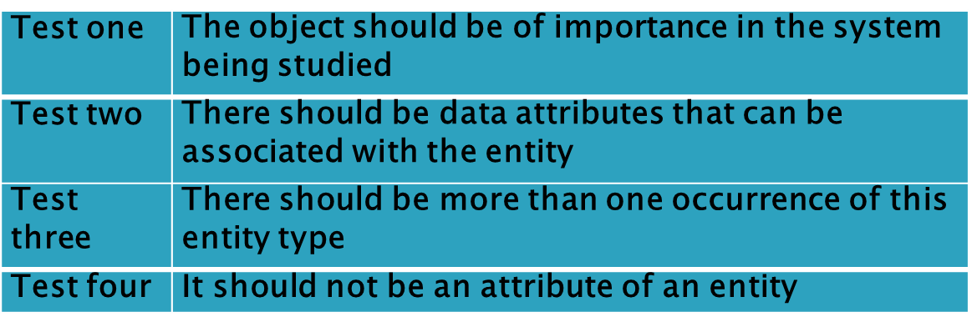
Remove Candidate Entity Types failing any of the 4 tests
Formula One example
There are 11 F1 Teams e.g. Mercedes, McLaren, Ferrari, Williams etc. which engage drivers to take part in the F1 World Championship. Each F1 Team is based in one country e.g. Williams and McLaren are British, Mercedes is German etc.. F1 Teams contract drivers to race for them in the 20 races which take place each year.

Slide 25
Remove Candidate Entity Types failing any of the 4 tests
Formula One example
There are 11 F1 Teams e.g. Mercedes, McLaren, Ferrari, Williams etc. which engage drivers to take part in the F1 World Championship. Each F1 Team is based in one country e.g. Williams and McLaren are British, Mercedes is German etc.. F1 Teams contract drivers to race for them in the 20 races which take place each year.

Slide 26
Remove Candidate Entity Types failing any of the 4 tests
Formula One example
There are 11 F1 Teams e.g. Mercedes, McLaren, Ferrari, Williams etc. which engage drivers to take part in the F1 World Championship. Each F1 Team is based in one country e.g. Williams and McLaren are British, Mercedes is German etc.. F1 Teams contract drivers to race for them in the 20 races which take place each year.

Slide 27
Identify Attributes
Formula One example
There are 11 F1 Teams e.g. Mercedes, McLaren, Ferrari, Williams etc. which engage drivers to take part in the F1 World Championship. Each F1 Team is based in one country e.g. Williams and McLaren are British, Mercedes is German etc.. F1 Teams contract drivers to race for them in the 20 races which take place each year.

Slide 28
Entity Type Definition
Entity Type | Attributes | Entity Description
TEAM | Team name, Base, … | A support team in the Formula One Championship
DRIVER | Surname, First names, country, … | A driver contracted to drive in the Formula One Championship
RACE | Race Number, race year, race date, … | A date at an approved location at which the Formula One Championship takes place

Slide 29
Entity Type Definition - more attributes
Entity Type | Attributes | Entity Description
TEAM | Team name, Full Teamname, Base, First Year, Power unit | A support team in the Formula One Championship
DRIVER | Surname, First names, Date of birth, country, place of birth | A driver contracted to drive in the Formula One Championship
RACE | Race Number, track name, race year, race date | A date at an approved location at which the Formula One Championship takes place

Slide 30
Entity Type Definition - more attributes
Entity Type | Attributes | Entity Description
TEAM | Team name, Full Teamname, Base, First Year, Power unit | A support team in the Formula One Championship
DRIVER | Surname, First names, Date of birth, country, place of birth | A driver contracted to drive in the Formula One Championship
RACE | Race Number, track name, race year, race date | A date at an approved location at which the Formula One Championship takes place
Identifying Attributes?

Slide 31
Entity Type Definition with identifying attribute
Entity Type | Attributes | Entity Description
TEAM | Team name, Full Teamname, Base, First Year, Power unit | A support team in the Formula One Championship
DRIVER | Driver no, Surname, First names, Date of birth, country, place of birth | A driver contracted to drive in the Formula One Championship
RACE | Race Number, track name, race year, race date | A date at an approved location at which the Formula One Championship takes place

Slide 32
Review
Introduction to the module – Assessment overview, dates, times, types
What are databases, who uses them
Database Design Stages – Conceptual Analysis, Logical Analysis, Physical Implementation
Conceptual Analysis - Entity Types, Candidate Entity Types, 4 tests of Entity Types, Attributes, Entity Descriptions, Identifying Attributes,
Occurrences, Attribute Values
More Data Modelling next week - Relationships

